Slide 1
Flash Flood Prediction Program Training Douglas County, Colorado March 7, 2011
Urban Drainage and Flood Control District
Genesis Weather Solutions
Skyview Weather
JP Consulting

Slide 2
AGENDA
Introductions
F2P2 History and Purpose
Private Meteorological Service’s (PMS) role in the District’s Flash Flood Prediction Program (F2P2)
Forecast products and issuance criteria
Douglas County F2P2 Statistics
Group discussion/Questions/Feedback
Notes:
Kevin will take the first bullet. GWS/Skyview the next 3. The last bullet we done together. Let’s add a simple criteria slide and “Forecast Products”

Slide 3
Urban Drainage & Flood Control District Flood Warning Program
A Federal/Regional/Local Early Warning Partnership
Kevin G. Stewart, P.E.
Manager, Information Services & Flood Warning Program
Serving the greater Denver/Boulder metropolitan area since 1979 in cooperation with NOAA’s National Weather Service

Slide 4
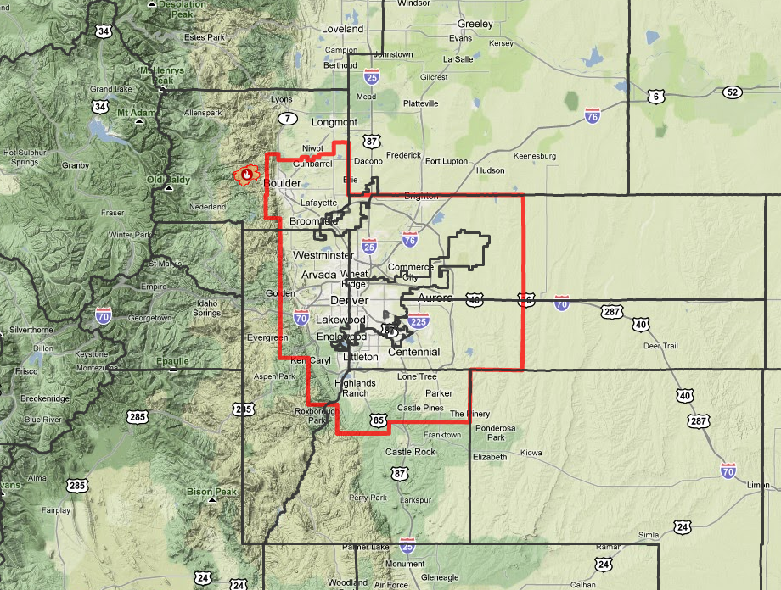
UDFCD Boundary

Slide 5
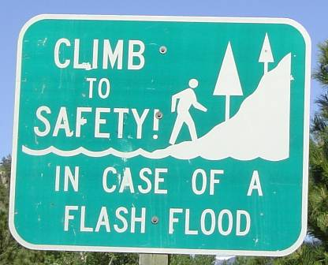
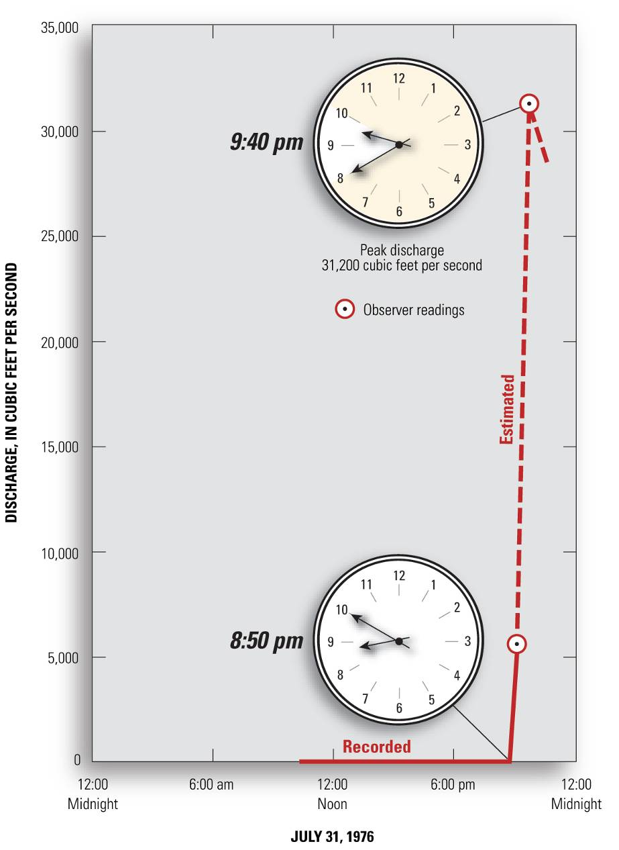
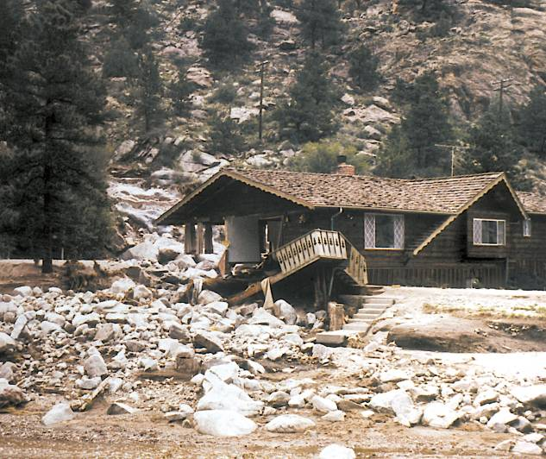
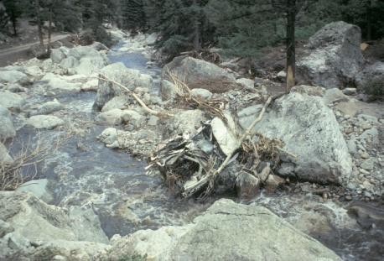
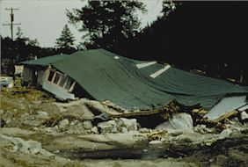
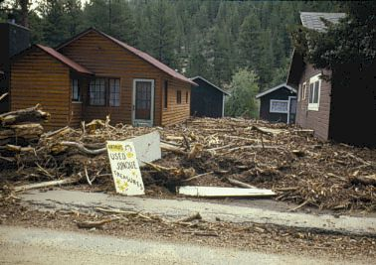
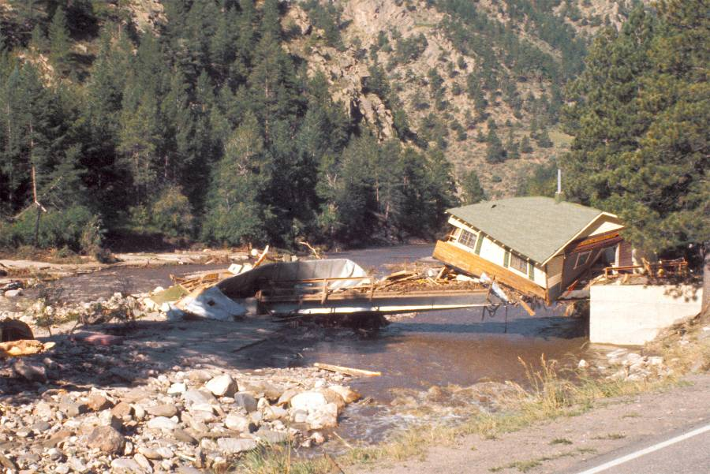
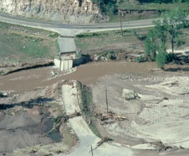
MOTIVATION FOR F2P2 1976 Big Thompson Canyon Flash Flood
19-foot flood depth
Big Thompson River
at Canyon Mouth
July 31, 1976

Slide 6
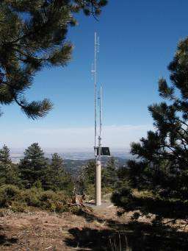
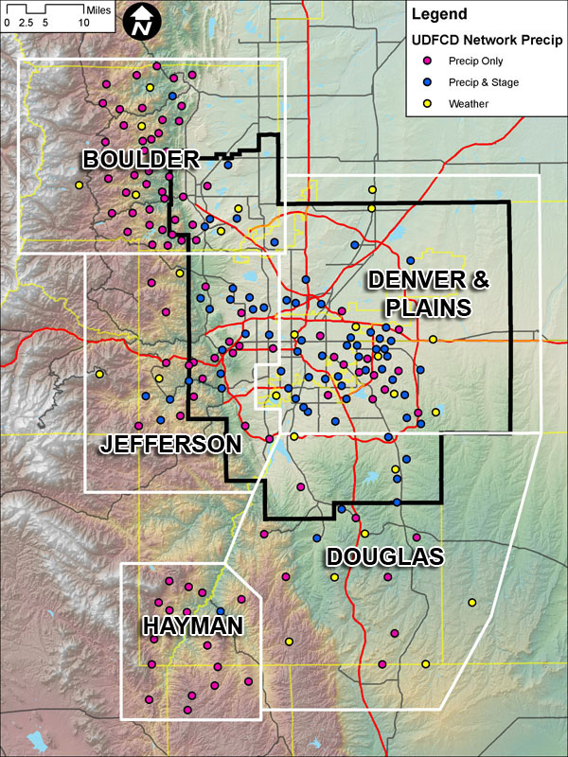
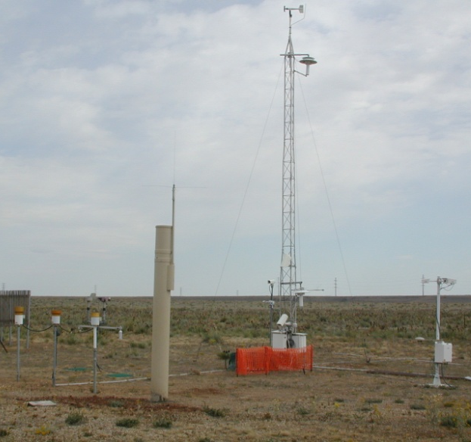
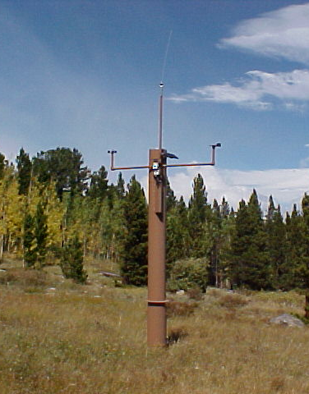
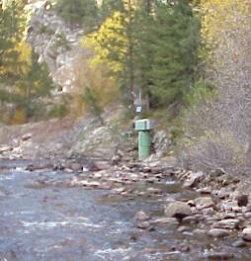
District ALERT Gaging Network
Notes:
6

Slide 7
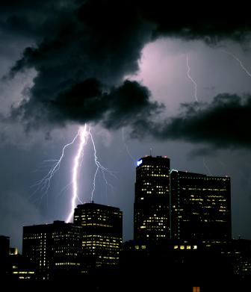
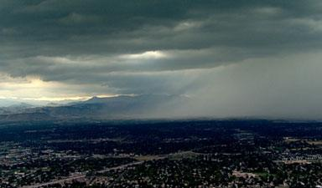
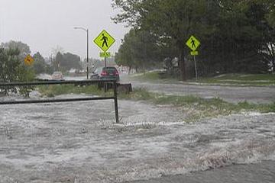
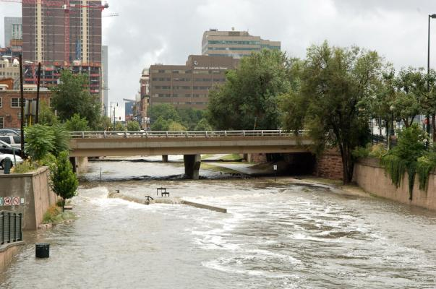
Flood Warning Program
Primary Mission
Provide local governments with early notifications of potential and imminent flood threats (primarily flash flood threats) in time to take appropriate defensive actions.
Saving lives and property

Slide 8
Meteorological Support
Genesis Weather Solutions & Skyview Weather

Slide 9
KEY PERSONNEL
Bryan Rappolt – Genesis Weather Solutions, LLC
Established Genesis Weather Solutions, LLC in 2005
HDR Engineering, Hydro-meteorological Division – Project Manager 2001 - 2005
Henz Meteorological Services – Operational and Consulting Meteorologist 1992 - 2001
Tim Tonge – Skyview Weather
Acquired Skyview Weather in 1995
Skyview Weather 1994 - 1995
Brad Simmons – Skyview Weather
Skyview Weather 2005 - Present
Chris Anderson– Junior Meteorologist
See my note below…
Notes:
Resume’s are not important to these people in my opinion. How about replacing this slide with a nice collage of your faces and names. You can say what you want to about your experience if you wish. Associating names with faces is more important.

Slide 10
PROJECT ROLES & RESPONSIBILITIES
Bryan Rappolt – Project Manager, Senior Operational Meteorologist, Quality Assurance and Quality Control (QA/QC)
Tim Tonge – Senior Weather Forecaster and Communications Manager
Brad Simmons – Operational Meteorologist
Chris Anderson– Junior Meteorologist
Eliminate slide…see my previous comment.

Slide 11
F2P2 PRIMARY OBJECTIVE
Predict and disseminate information to District local governments about potential and imminent flood threats (primarily flash flood threats) based on meteorological conditions before heavy rainfall occurs, thus providing local governments with adequate lead-time to respond pro-actively and effectively.
Saving lives and property

Slide 12
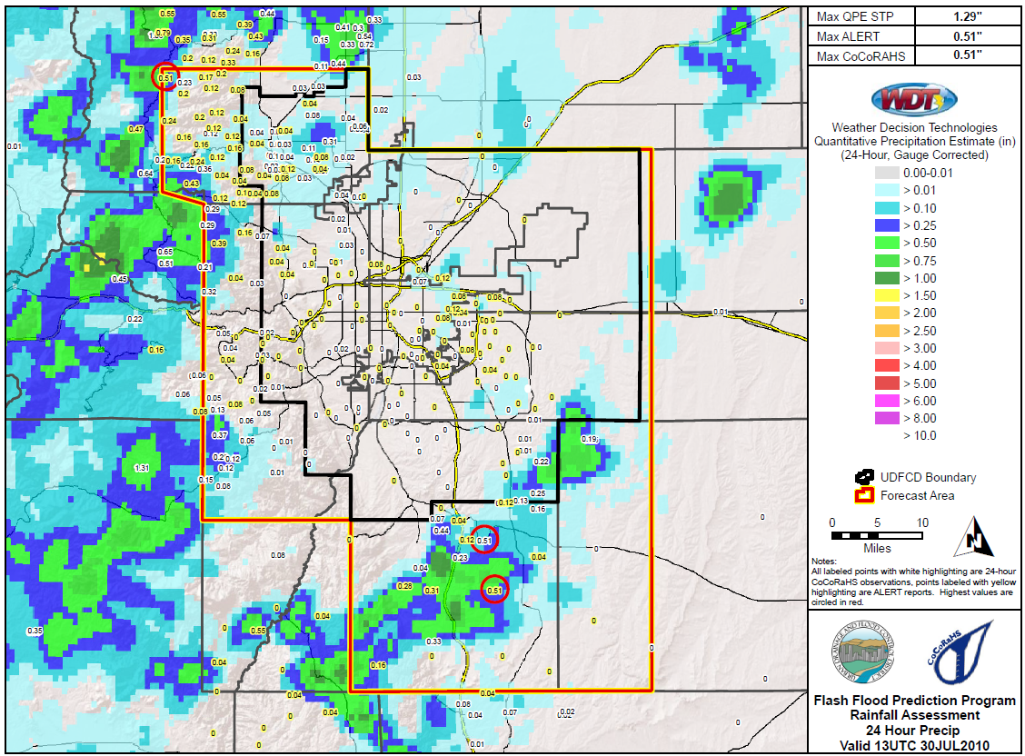
F2P2 FORECAST AREA
~ 3000 mi^{^2}
Population: ~ 2.8 million
Elevation Range: 5,000 to 10,500 feet

Slide 13
ROLE OF THE PMS
Metwatch: Provide meteorological watch (Metwatch) for weather conditions capable of producing flooding.
Internal Notifications (Messages): Notify affected local governments whenever potential or imminent flood threats exist.
Basin-Specific Flood Warning Plans: Provide operational support to local governments and participate in exercises.
NWS Coordination: Maintain communications with the National Weather Service Forecast Office in Boulder.
Communications Log: Maintain written record of all verbal communications and forecast products issued.
Reservoir Release Notifications: Notify affected local governments of reservoir releases from Cherry Creek, Chatfield and Bear Creek Lake dams by the U.S. Army Corps of Engineers.

Slide 14
MESSAGE CRITERIA

Slide 15
F2P2 Bulletin Board Products
Daily by 11AM
Most Anticipated
After Message Issuance
>1.5 in/hr Potential
Notes:
Refer to handouts for content specifics.

Slide 16
F2P2 Notifications
Message 1: Street Flood Advisory – potential threat of low impact or “nuisance” flooding
Red Flood Alert: imminent threat of low impact flooding
Message 2: NWS Flash Flood Watch – potential high threat to life and property
Message 3: NWS Flash Flood Warning – imminent or occurring threat to life & property
Message 4: All Clear!
Notes:
Emphasize imminent vs. potential threats, and low to moderate vs. high threats to people and property.
Refer to handouts for content specifics.

Slide 17
WHY NUMBERED MESSAGES INSTEAD OF JUST PLAIN LANGUAGE?
The term “MESSAGE” identifies UDFCD’s private meteorologist as the information source. NWS never uses this term in their products.
Avoids confusion with comparable NWS products:
Urban and Small Stream Flood Advisory (F2P2 Message 1 & RFA)
Flood Watch/Flash Flood Watch (F2P2 Message 2)
Flood Warning/Flash Flood Warning (F2P2 Message 3)
Numbers (1,2,3,4) and code words like “Red Flood Alert” indicate threat levels and urgency.

Slide 18
HOW F2P2 PRODUCTS ARE DISSEMINATED
Telephone – Product reception verification and specific weather information - “Verbal handholding”
Email – Sent as a color pdf attachment
Email – Short Message Service (SMS)
Website – Posted on F2P2 products webpage
Pager – Text messages sent to alphanumeric pagers
Fax – Hardcopy black/white products

Slide 19
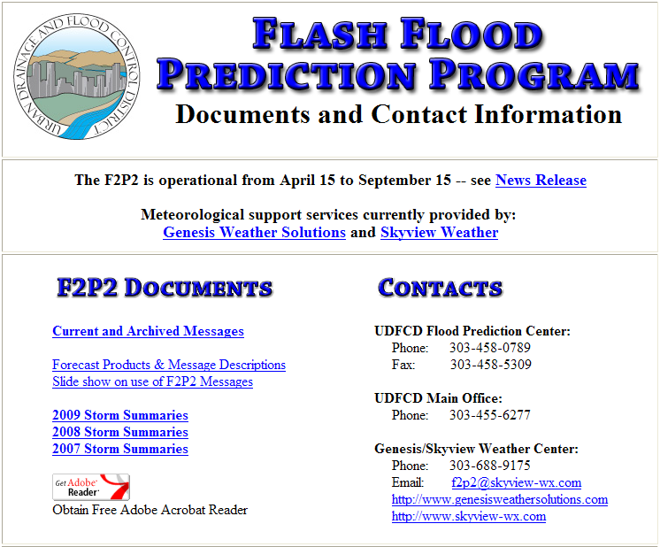
F2P2 MAIN WEBPAGE – http://f2p2.udfcd.org

Slide 20
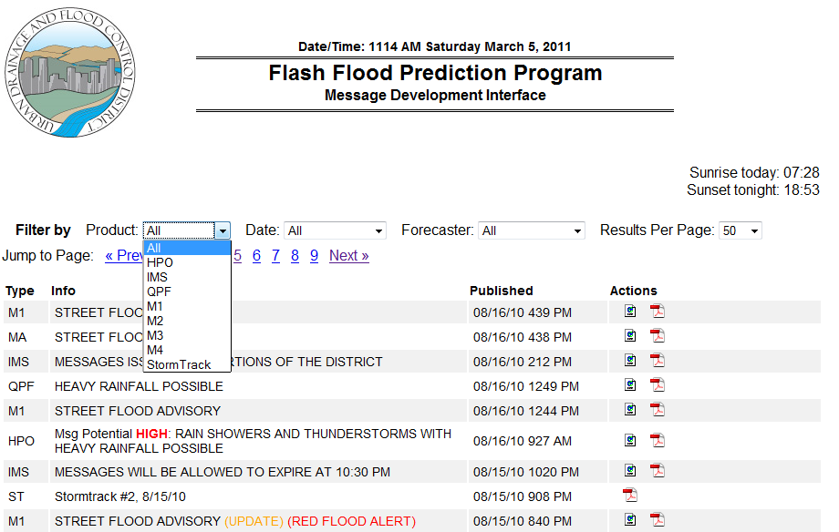
F2P2 PRODUCTS WEBPAGE
http://f2p2.udfcd.org/generator/

Slide 21
DISTRICT FWP SUBSCRIPTION WEBPAGE http://lists.udfcd.org

Slide 22
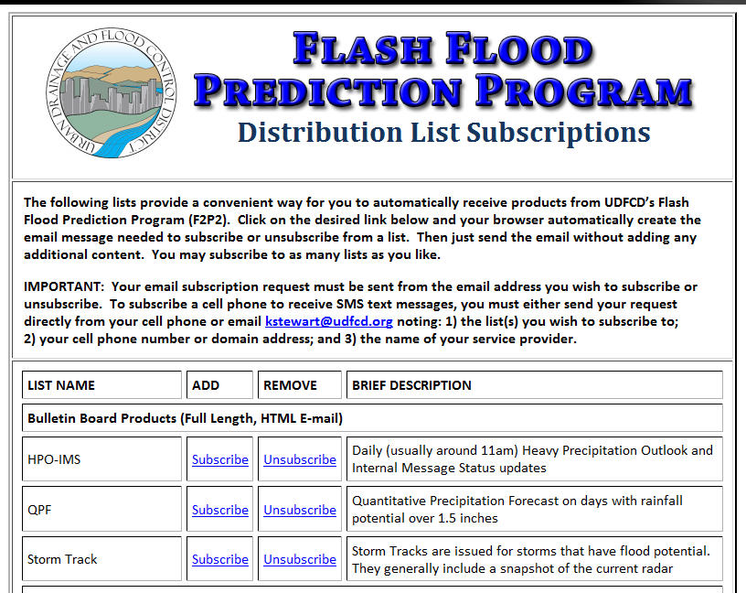
F2P2 EMAIL SUBSCRIPTIONS

Slide 23
…more F2P2 SUBSCRIPTIONS
Daily Message Potential
Notes:
Move yellow highlight box to correspond to respective training.

Slide 24
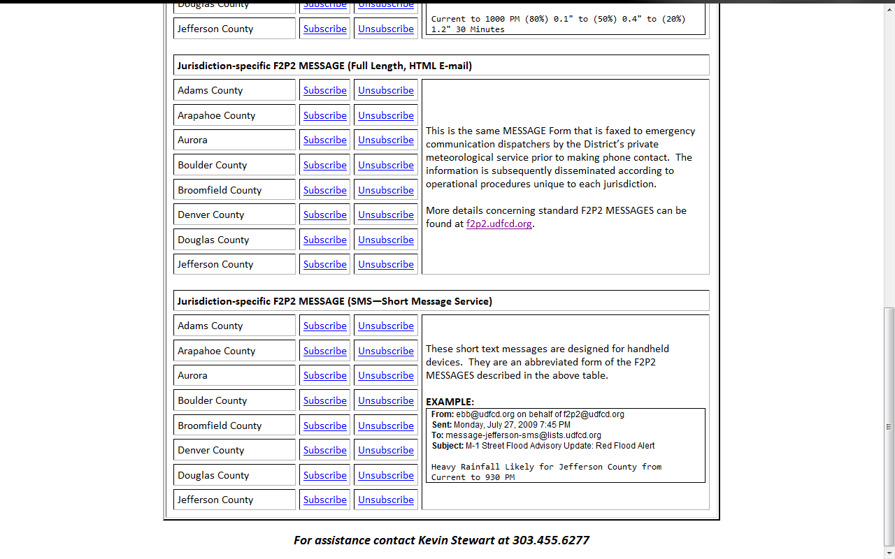
…more F2P2 SUBSCRIPTIONS
MESSAGES
Notes:
Move yellow highlight box to correspond to respective training.

Slide 25
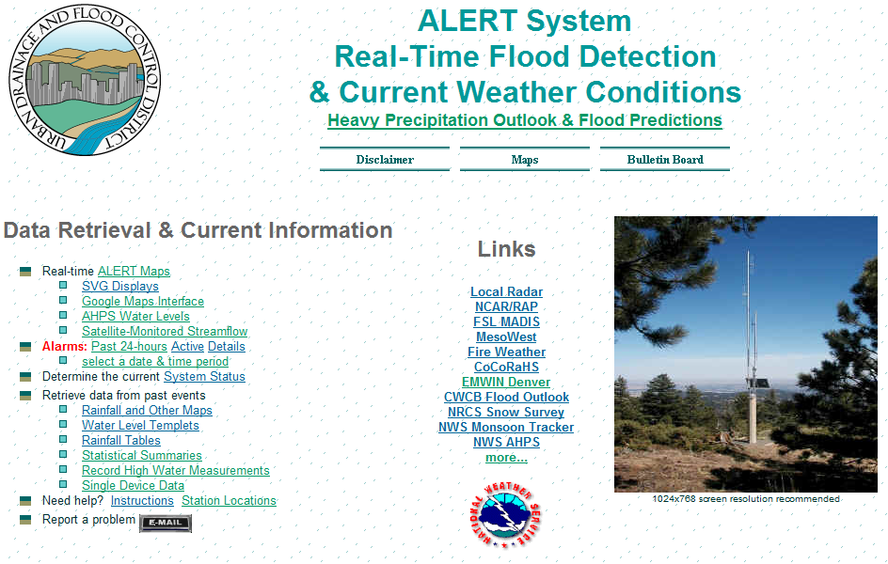
ALERT SYSTEM WEBPAGE
http://alert2.udfcd.org
F2P2 Webpage

Slide 26
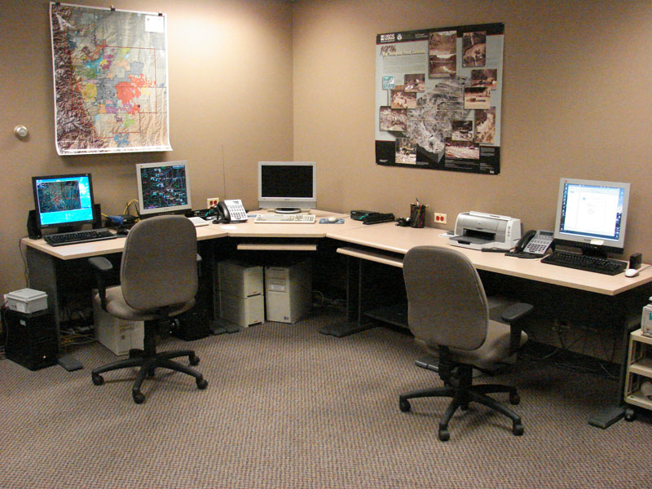
F2P2 FLOOD PREDICTION CENTER (FPC)

Slide 27
F2P2 CONTACT INFORMATION
Flood Prediction Center (FPC): 303.458.0789 Staffed only when MESSAGES are in effect.
Skyview Weather (WPC-1): 303.688.9175
Genesis Weather Solutions (WPC-2): 303.927.6522
Email: f2p2@skyview-wx.com
UDFCD: 303.455.6277

Slide 28
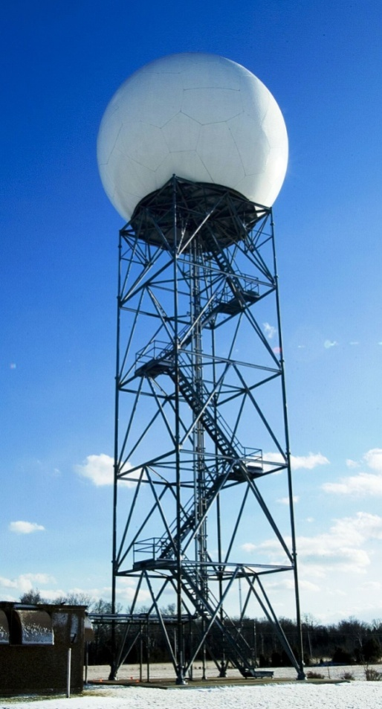
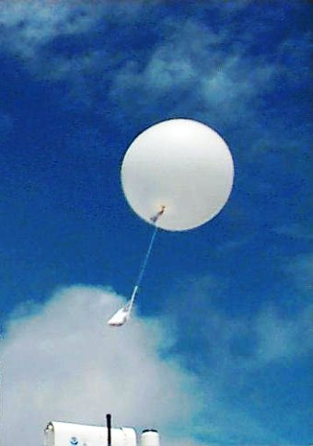
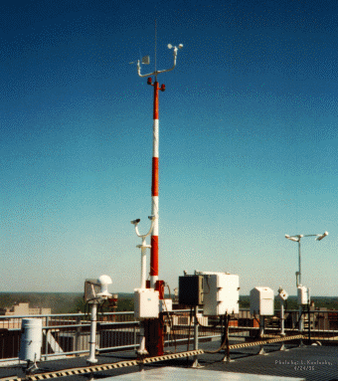
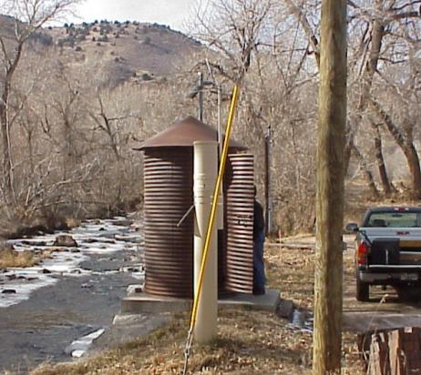
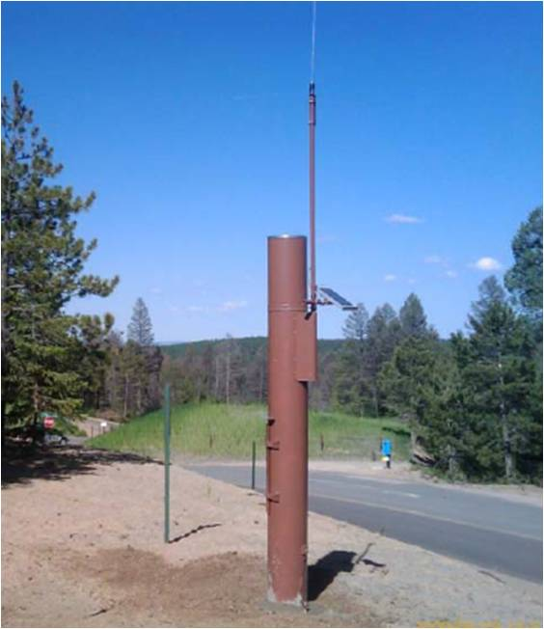
WEATHER DATA & REAL-TIME OBSERVATIONS
Radar, satellite, upper air soundings, profilers, ACARS, lightning detection, rainfall, stream levels, weather stations, spotter reports
Notes:
Talk about the data sources used by meteorologist to predict the weather and metwatch when conditions warrant. An important part of what you do, but too many screen grabs may distract from main focus—Communications.

Slide 29
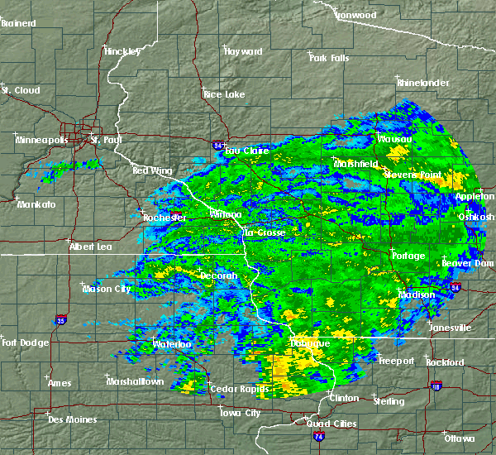
Situational Awareness
Many useful Internet tools for forecasters and decision makers.

Slide 30
DOUGLAS COUNTY F2P2 STATISTICS
24
12
10
4
Year | Message 1 | RFA | Message 2 | Message 3 | Voice Contact
2007 | 34 | 12 | 4 | 0 | 56
2008 | 16 | 4 | 6 | 0 | 30
2009 | 46 | 24 | 0 | 1 | 74
2010 | 27 | 10 | 4 | 0 | 44

Slide 31
Thank you for listening
Urban Drainage and Flood Control District
Flash Flood Prediction Program Training Douglas County, Colorado, March 7, 2011
Feedback…Questions…Comments

